Slide 1
Artificial Intelligence

Slide 2
Outline
Today
Adversarial Search
Formalization of the problem
Game Tree
Mini Max Algorithm
Alpha-beta Pruning

Slide 3
Single Agent environment
Until now, we have discussed single agent environment
only one person or agent searching the solution space to find the goal or the solution.
often expressed in the form of a sequence of actions
There might be some situations where more than one agent/person is searching for the solution in the same search space
usually occurs in game playing where two opponents (adversaries) are searching for a goal.
Multi-agent environment
Notes:
Search strategies were only associated with a single agent/person that aims to find the solution

Slide 4
Multi-agent environment
The environment with more than one agent
Each agent is an opponent of other agent and playing against each other
Each agent needs to consider the action of other agent and effect of that action on their performance.

Slide 5
Adversarial Search
Adversarial Search
Searches in which two or more players with conflicting goals are trying to explore the same search space for the solution
often known as Games
For example, in a game of tic-tac-toe player one might want that he should complete a line with crosses while at the same time player two wants to complete a line of zeros
Notes:
For example, in a game of tic-tac-toe player one might want that he should complete a line with crosses while at the same time player two wants to complete a line of zeros. Hence both have different goals. Notice further that if player one puts a cross in any box, player-two will intelligently try to make a move that would leave player-one with minimum chance to win, that is, he will try to stop player-one from completing a line of crosses and at the same time will try to complete his line of zeros.
A search, where we examine the problem which arises when we try to plan ahead of the world and other agents are planning against us
Games are modeled as a Search problem and heuristic evaluation function, and these are the two main factors which help to model and solve games in AI.

Slide 6
Contd..
Deterministic games
Those games which follow a strict pattern and set of rules for the games, and there is no randomness associated with them.
Examples are chess, Checkers, Go, tic-tac-toe, etc.
Non-deterministic games
Those games which have various unpredictable events and has a factor of chance or luck.
This factor of chance or luck is introduced by either dice or cards. These are random, and each action response is not fixed.
Also called as stochastic games.
Example: Monopoly, Poker, etc.

Slide 7
Zero-Sum Game
Adversarial search which involves pure competition.
Each agent's gain or loss of utility is exactly balanced by the losses or gains of utility of another agent.
One player of the game try to maximize one single value, while other player tries to minimize it.
Each move by one player in the game is called as ply.
Example:
Chess and tic-tac-toe.

Slide 8
Formalization of the problem
A game can be defined as a type of search in AI which can be formalized of the following elements:
Initial state
It specifies how the game is set up at the start.
Player(s)
It specifies which player has moved in the state space.
Action(s)
It returns the set of legal moves in state space.
Result(s, a)
It is the transition model, which specifies the result of moves in the state space.

Slide 9
Contd..
Terminal-Test(s)
The state where the game ends is called terminal states.
Terminal test is true if the game is over, else it is false at any case.
Utility(s, p)
A utility function gives the final numeric value for a game that ends in terminal states s for player p. It is also called payoff function. (Reward after winning the game)
For Chess, the outcomes are a win, loss, or draw and its payoff values are +1, 0, ½. And for tic-tac-toe, utility values are +1, -1, and 0

Slide 10
Game tree
A game tree is a tree where nodes of the tree are the game states and Edges of the tree are the moves by players.

Slide 11
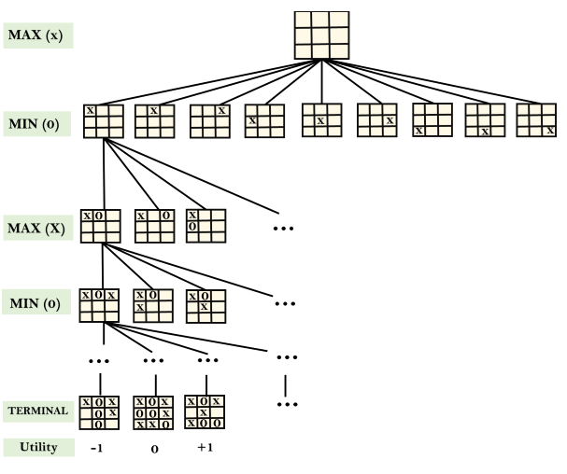
Tic-Tac-Toe game tree

Slide 12
Mini-Max Algorithm
A recursive or backtracking algorithm
The algorithm proceeds all the way down to the terminal node of the tree, compare the values and backtrack the tree to root node to decide the move.
Performs a depth-first search algorithm for the exploration of the complete game tree.
Why not BFS??
Best Move strategy used
Both players will adopt best move to not allow the opponent to win
Computes the minimax decision for the current state
Max will try to maximize its utility (Best move)
Min will try to minimize the utility (Worst move)
Notes:
1. Mini-max algorithm is a recursive or backtracking algorithm which is used in decision-making and game theory. It provides an optimal move for the player assuming that opponent is also playing optimally.

Slide 13
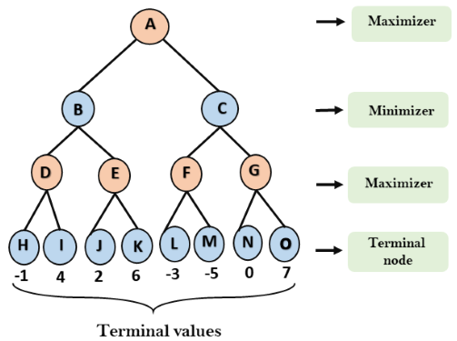
Working of Min-Max Algorithm
In the first step, the algorithm generates the entire game-tree and applies the utility function to get the utility values for the terminal states
Notes:
An example of game-tree which is representing the two-player game
Here max will try to increase its utility, i.e will think to move A->C->G->O for max value of 7, but max has only one move and its next move is dependent on the move of opponent where min will try to minimize the value of max.

Slide 14
Contd..
Step 1
let's take A is the initial state of the tree. Suppose maximizer takes first turn (normally max takes first move)
Then min will take second move and then again max, so on
Step2
Start from terminal values, and find utilities for the maximizer by comparing the values of terminal nodes
For node D max(-1,4)= 4
For Node E max(2, 6)= 6
For Node F max(-3,-5) = -3
For node G max(0, 7) = 7

Slide 15
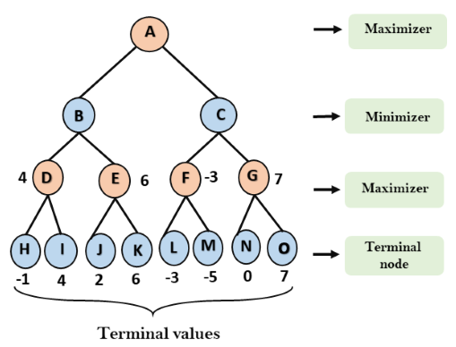
Contd..

Slide 16
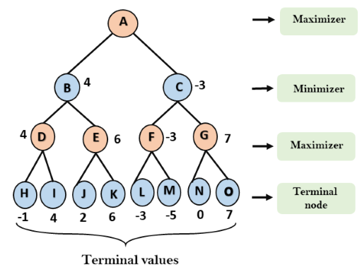
Contd..
Step 3
In the next step, it's a turn for minimizer
it will compare all nodes value, and will find the min values.
For node B= min(4,6) = 4 For node C= min (-3, 7) = -3

Slide 17

Contd..
Step 4
Now it's a turn for Maximizer, and it will again choose the maximum of all nodes value and find the maximum value for the root node. i.e. For node A max(4, -3)= 4

Slide 18
Contd..
So, if max follows A->B->D->I, it will definitely win with the utility of 4.

Slide 19
Task
A
B
C
D
E
F
G
H
I
J
K
L
M
N
O
-1
8
-3
-1
2
1
-3
4
Notes:
A->C->F->L with utility of 2

Slide 20
Performance Measurement
Complete ?
YES, It will definitely find a solution (if exist), in the finite search tree.
Optimal ?
YES, if both opponents are playing optimally
Time ?
The worst case time complexity is O(b^{d}).
Space ?
The worst case space complexity is O(b^{d}).

Slide 21
Limitation of the minimax Algorithm
The main drawback of the minimax algorithm is that it gets really slow for complex games such as Chess, go, etc.
This type of games has a huge branching factor, and the player has lots of choices to decide
Traversing becomes complex
Solution
alpha-beta pruning to reduce the tree and increase efficiency
Notes:
For chess, on average 35 choices are possible at a single time. Means 35 branches ,
And on average depth for a single player is 50, then for two players will be 100, so (35)^100
That will make a big game tree and traversing becomes difficult and complex.
https://www.youtube.com/watch?v=Ntu8nNBL28o&ab_channel=GateSmashers

Slide 22
Alpha-Beta Pruning
An optimization technique/ modified version of the minimax algorithm.
We cannot eliminate the exponential expansion of minimax, but we can cut it to half using pruning technique
A technique by which without checking each node of the game tree we can compute the correct minimax decision
Pruning makes the algorithm fast, as sometimes it not only prunes the leaves but also entire sub-tree that is not really affecting the final decision but making algorithm slow

Slide 23
Contd..
Involves two threshold parameter Alpha and beta for future expansion, so name alpha-beta pruning/Algo.
The two-parameter can be defined as:
Alpha: The best (highest-value) choice we have found so far at any point along the path of Maximizer. The initial value of alpha is -∞.
Beta: The best (lowest-value) choice we have found so far at any point along the path of Minimizer. The initial value of beta is +∞.
Cut off search by exploring less no of nodes
If a best path is found, remaining paths are not explored instead we cut off them

Slide 24
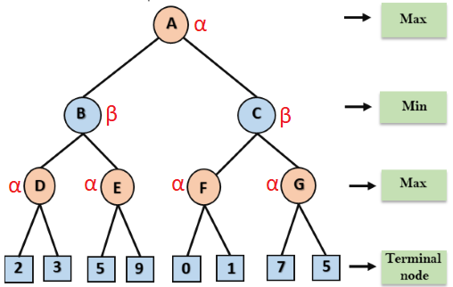
Example
Step 1: At the first step the, Max player will start first move from node A (Max), will move downwards to B->D and terminal node and find α and β values using utility values.

Slide 25
Contd..
Step 2: at node D, left value of 2 will be assigned to α. Now it’s mean that value of D will be ≥ 2 as its max turn. Now check other node that has value of 3 and it is turn of Max, so α value be updated with 3 and D node will have value of 3.
Step 3: now at node B, assign value of node D to β at node B. as its min turn its mean node B will have value ≤ 3.
After that, next successor E will be traversed which will get value of α=5 from left leaf of E. as it’s max turn, its mean that node E will have value of ≥ 5, where as node B already have a minimum value of 3. So, there is no need to traverse the other successor of E and hence pruned.

Slide 26
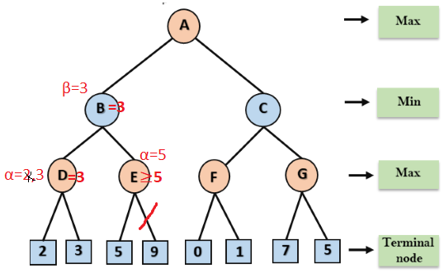
Contd..

Slide 27
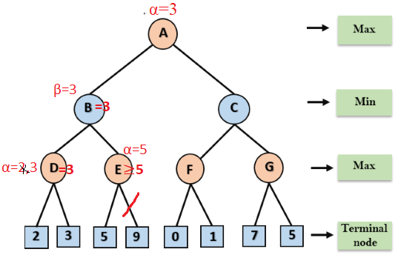
Contd..
Step 4: now at node A, α will get value of 3. as its turn of max, so value of A will be ≥ 3.
Here any other path that will give value less than 3 will be pruned.

Slide 28
Contd..
Step 5:Now, node C from right side will be traversed, which will go downward to F and F will get value of 0 for α. As it s turn of Max so value for F will be ≥ 0. right successor of F has value 1, so α value be updated with 1 and F will get max value of 1.
Step 6: F will return value of 1 to β at node C. as its turn of Min and value of C will be ≤ 1, whereas node A already has max value of 3, so another value generated after traversing nodes further will return value ≤ 1. Therefore, no need to explore further and right complete branch of C will be pruned.
A will retain utility value of 3 i.e. optimal value for maximizer.

Slide 29
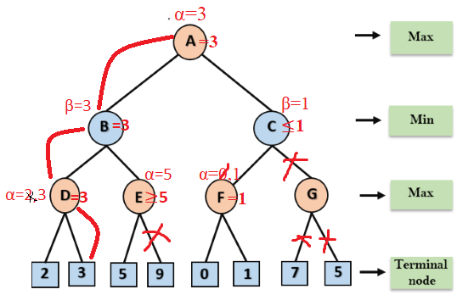
Contd..
So, So, if max follows A->B->D->I, it will definitely win with the utility of 3.
Notes:
So, alpha beta algorithm is much efficient than minmax.

Slide 30
Complexity
Complexity is dependent on traversal ordering of nodes. It can be of two types:
Worst ordering
In some cases, alpha-beta pruning algorithm does not prune any of the leaves of the tree, and works exactly as minimax algorithm.
In this case, the best move occurs on the right side of the tree and it also consumes more time because of alpha-beta factors.
The time complexity for such an order is O(b^{d}).
Ideal ordering:
The ideal ordering for alpha-beta pruning occurs when lots of pruning happens in the tree, and best moves occur at the left side of the tree.
We apply DFS hence, it first search left of the tree and go deep twice as minimax algorithm in the same amount of time.
Complexity in ideal ordering is O(b^{d/2}).

Slide 31
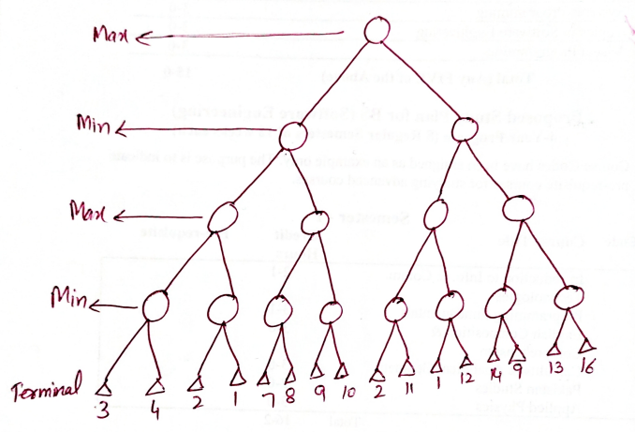
Task
Find the best path and optimal value for Max using alpha-beta pruning.

Slide 32
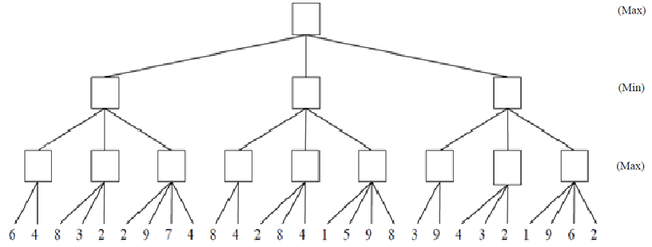
Assignment 2
Find the best path and optimal value for Max using alpha-beta pruning.

Slide 33
END

